Slide 1
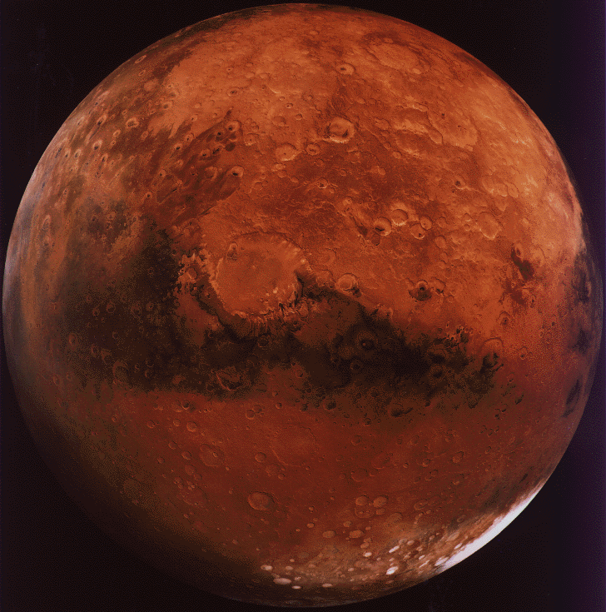
Mars One-Project
By - Mercedes

Slide 2
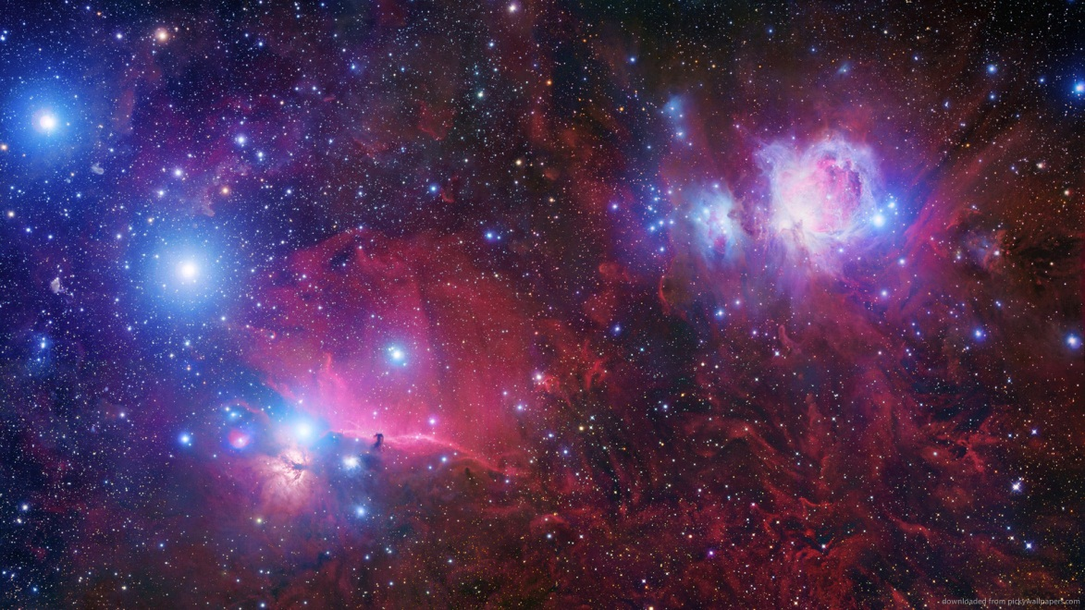
Personal Traits
I am…
Resilient
Adaptable
Trustworthy/Trusting
Creative
Resourceful

Slide 3
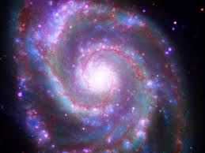
What I bring to the Program
Organization
Ill keep a tidy/organized space station
Prepare Food for others
Counselling services, I can fix any problem!
Leadership, I am a good Leader not a follower

Slide 4
Life Experience
By 2023, I hope to have….
Earned a graduate degree from university (M.Sc.)
Become a spouse and parent
Be a community leader….volunteering
Be physically fit
Have secured employment

Slide 5
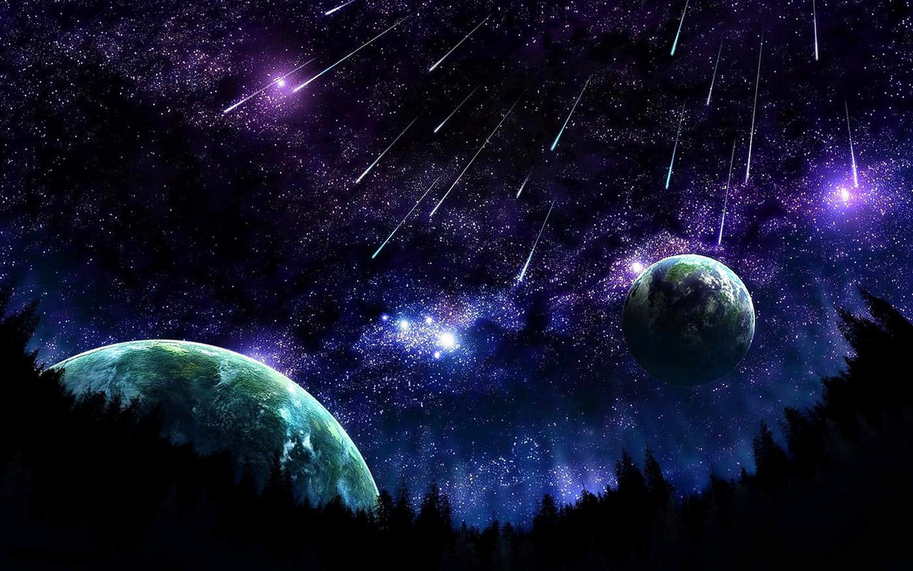
My most Difficult challenge
Not seeing my Family and Friends for a long period of time

Slide 6
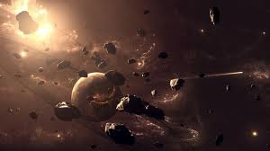
The thing I look most forward to…
Exploring new things
Having a unique chance to be the first people from planet Earth to visit Mars
To see if there is any intelligent life there

Slide 7
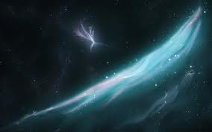
How to deal with Stress
Exercise
Sleep
Listen to music
Strive for excellence not perfection.
Tell someone to have a good day on Mars everyday

Slide 8
Anticipated Physical health Issues
A cold… bring Medicine
Insomnia… Bring Sleeping pills
Tooth ache… Bring a pair of Pliers, chewing on cloves
Cuts, Scrapes…Bring a first aid kit
If you break a leg… Bring crutches

Slide 9
I plan to deal with Mental Health Issues by…
Some Mental conditions which I might encounter…Loneliness, depression,& anxiety
Communicate with family and friends
Bring some self Help books to read
I’ll bring Medication
Do some yoga or meditation

Slide 10
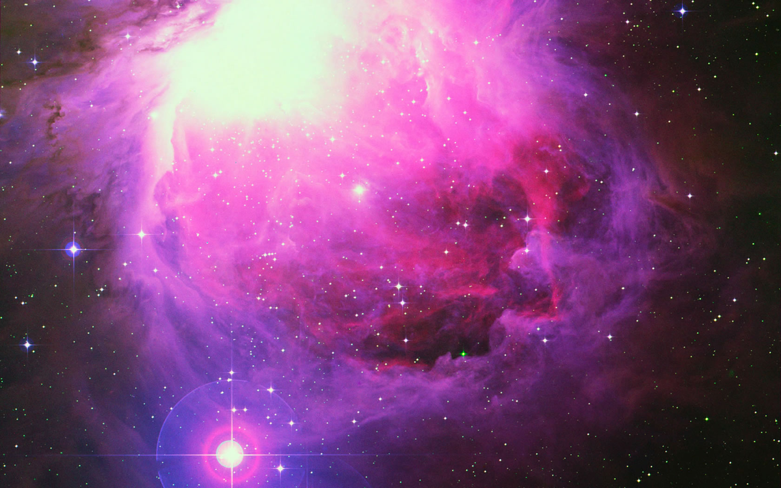
Day-to-Day Issues
Living in a non-gravity environment
Dealing with the same routine over and over
Living in a small confined space
Preparing meals
Disposing of garbage
Cleaning after yourself and others
Do a lot of practice on Earth in non-gravity simulators
Deal with it
Deal with it
There is no fresh food
Be very conscious of the garbage that I leave behind
Deal with it

Slide 11
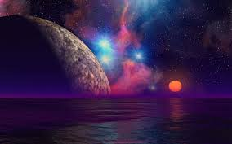
Relationship Issues
Home Sick
Separation from Family and Friends
Try to find a way to Communicate with other human life
Keep pictures of close friends and Family

Slide 12
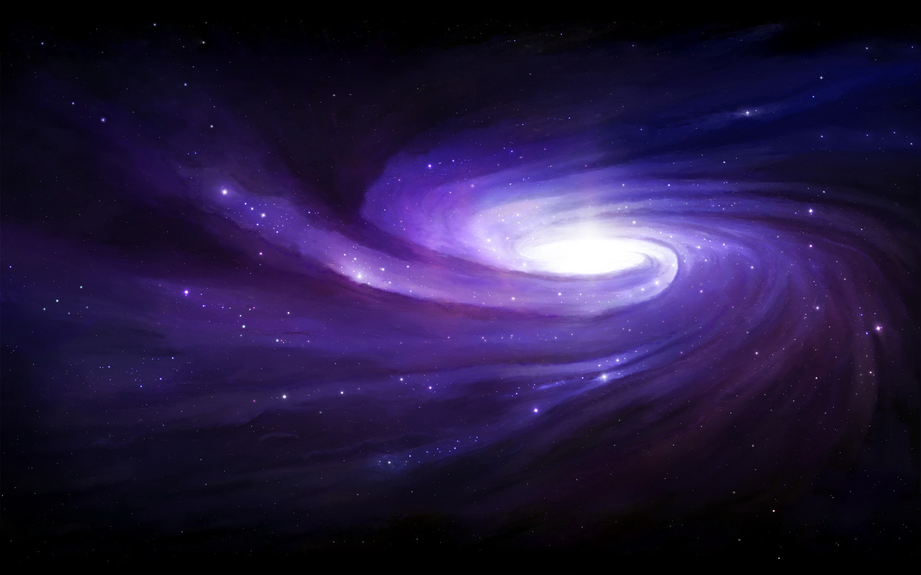
Resources
Bring enough water and food
Bring a machine for water and food
Try growing food somehow
Bring animals to provide food

Slide 13
Rules and Laws
Set up a democratic system of decision making
1 person = 1 vote
Everyone has a say in the creation of Rules and Laws, but the majority rules
Certain people will be elected to enforce and interpret the laws

Slide 14
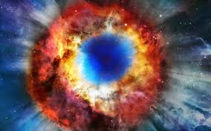
If I could bring one item from Earth I would bring…
I’d bring lots and lots of food
Because it is hard to grow crops in that environment

