Slide 1




These are my
Needs

Slide 2
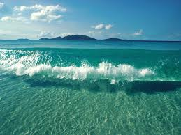
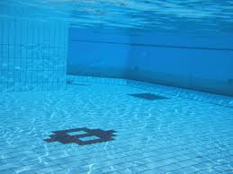
Fun
How I fill my fun need is swimming.

Slide 3
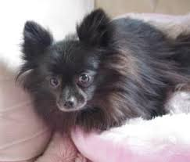

Love & Belonging
I love my dog I always be with her.
And I always love being with family.

Slide 4


Power
I really like drawing.

Slide 5
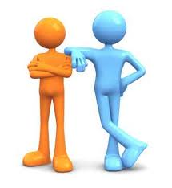

Freedom
I have good friends.

Slide 6
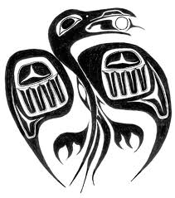
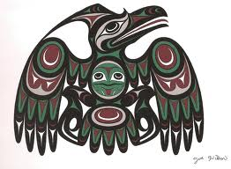
Cultural
This is my cultural pride.

Slide 7
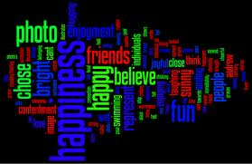
a

Slide 8


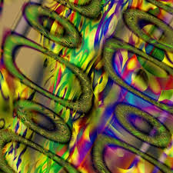
These are my character traits.
Friendly, Creative, and Smart.

Slide 9
This is my way to give back to the community.
The way I’ll give back to the community is help people to do homework and pick up garbage.

Slide 10
These are my basic needs
Fun, Power, Belonging, and Freedom. And also my cultural and character traits.

